Slide 1
Georges Seurat
(1859–1891)
France
History of Modern Art
BFA-III (Visual Arts)
Course Incharge: Ms. Sidra Liaqat
Institute of Design & Visual Arts, LCWU

Slide 2
“Some say they see poetry in my paintings; I see only science.”
- Georges Seurat

Slide 3
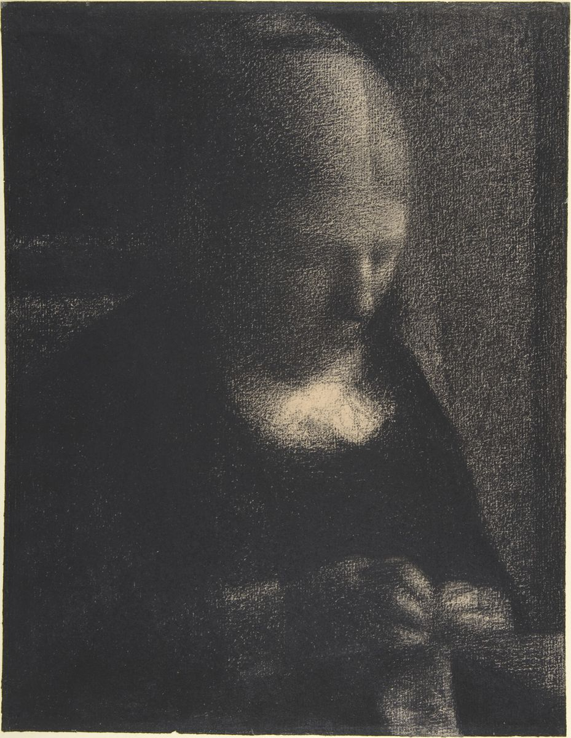
“Embroidery; The Artist's Mother”
(1883)

Slide 4
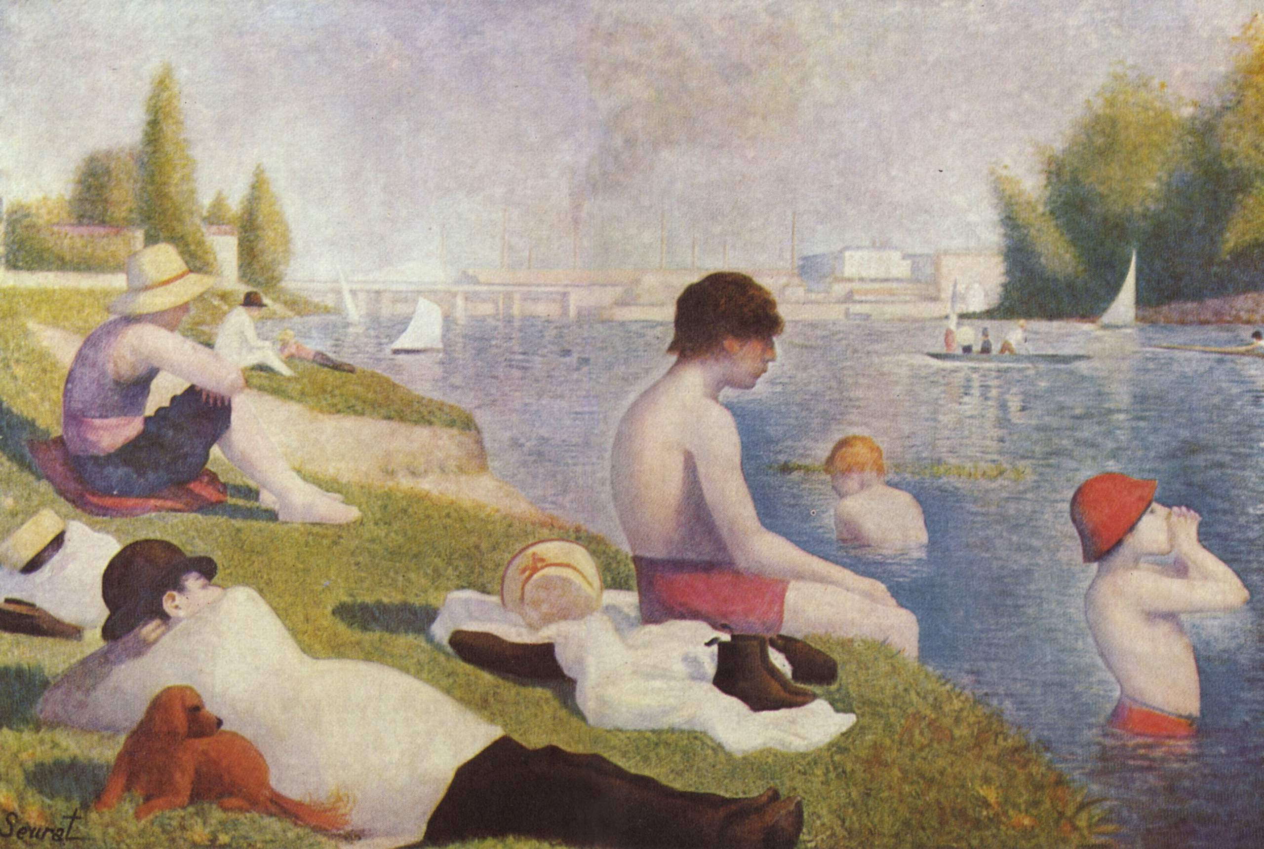
“Bathers at Asnières”
(1884)

Slide 5
“Sunday Afternoon on the Island of La Grand Jatte”
(1886)

Slide 6
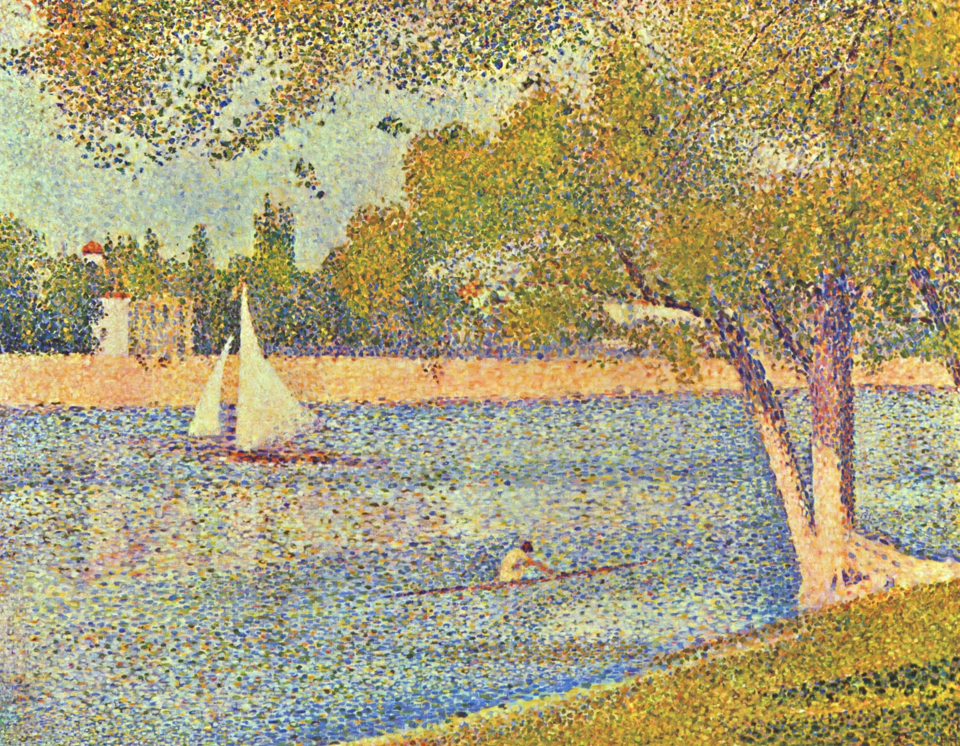
“The river Seine at La Grande-Jatte”
(1888)

Slide 7
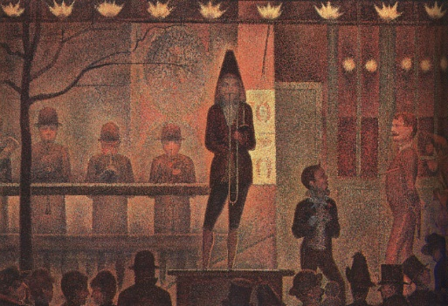
“Circus Sideshow”
(1888)

Slide 8
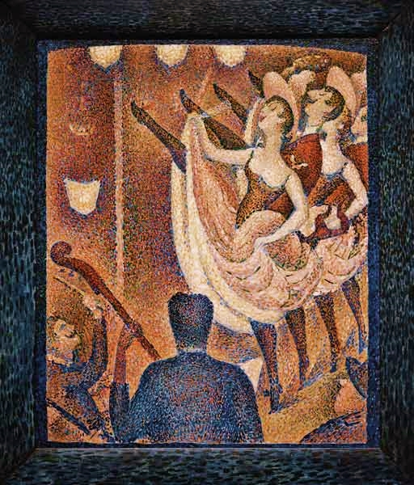
“Le Chahut”
(1889)

Slide 9
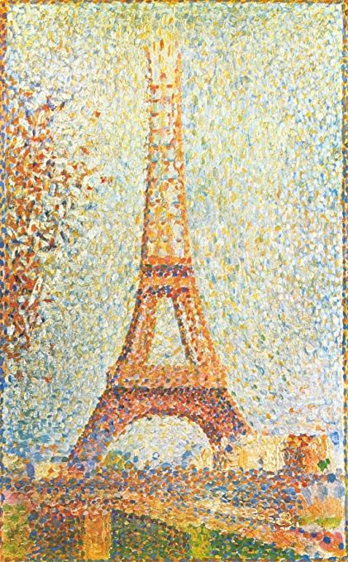
“The Eiffel Tower”
(1889)

Slide 10
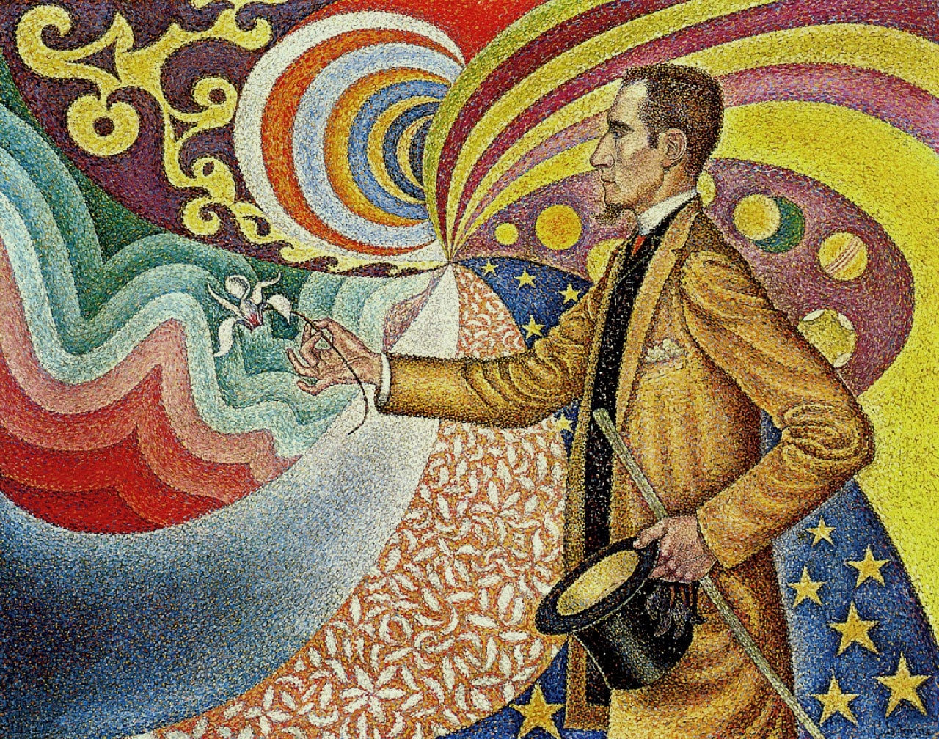
PAUL SIGNAC
“Portrait of M. Félix Fénéon, Against the Enamel of a Background Rhythmic with Beats and Angles, Tones, and Tints,”
(1890)

Slide 11
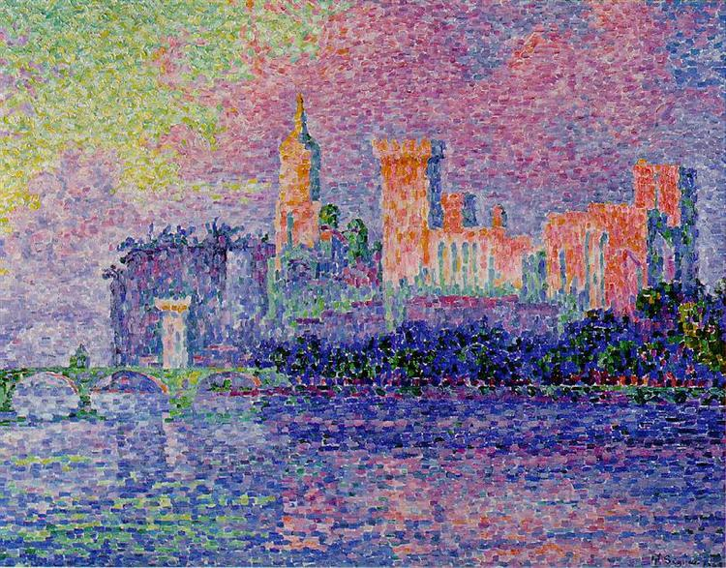
PAUL SIGNAC
“The Papal Palace”
(1900)

